Slide 1
Applecross Annual Meeting 2023
CAS HOA Management
Applecross HOA Board of Directors
October 12, 2023

Slide 2

Agenda
Call to Order
Introduction of current Board of Directors & Community Manager
President’s Report
Financial Report
July Financials
2024 Approved Budget
Nomination for Board of Directors & Elections
Questions
Adjournment

Slide 3

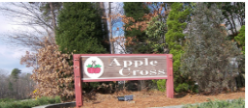
Our Team
Mat Cordialini, Community Manager
HOA Board of Directors:
About Applecross:
919-367-7711, ext. 1506
Email: Matt@casnc.com
Joanna Willard, President
Vice President, open position
Secretary/Treasurer, open position
Leigh LeClair, Director at Large
Mala Sistla, Director at Large
The Applecross townhome community was built in the 1980’s and is comprised of 149 townhomes within 28 buildings.
Website:
https://www.casnc.com/communities/applecross/

Slide 4
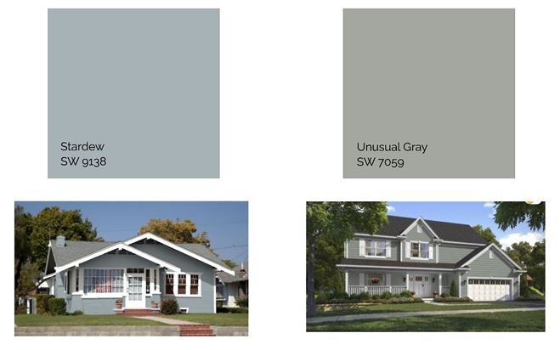
President’s Report
28-building Carpentry and Painting Project
Contract awarded to Color Spectrum LLC.
Hired professional Color Consultants to refresh our 1982 color palette to more updated neutrals.
Colors Selected: Sherwin Williams Stardew (SW9138) and Unusual Gray (SW7059) along with white trim.
Communication Plan: Include information in Annual Meeting packet and review at Annual Meeting. Once scheduled, notifications will be sent via Email, USPS, mailbox signs, and website.
Notes:
The Board recognized the need to update the 1980’s building color palette and performed their due diligence by consulting with Sherwin Williams color consultants as well as professional interior and color consultants MG Interiors (https://mgerrityinteriors.com/).

Slide 5
President’s Report, cont.
Applecross 28-building Carpentry and Painting Project Scope
In Scope | Out of Scope
The Project includes: Power washing Caulking Siding and trim repair and/or replacement Two coats of paint Includes: building siding, building trim, doors (front, back, storage, crawlspace), front porch posts, railings, and balusters, community entrance sign Once painting is completed, power washing of sidewalks | The following is NOT included in the Project: Front porch decking, stairs/steps, and risers Back deck decking, posts, railings, stairs/steps, and risers Owner-added items (e.g., yard fences, screened porches, ramps)
Notes:
The Board recognized the need to update the 1980’s building color palette and performed their due diligence by consulting with Sherwin Williams color consultants as well as professional interior and color consultants MG Interiors (https://mgerrityinteriors.com/). This also included a new color palette for the front doors which allows the residents a way to further individualize their home.

Slide 6
President’s Report, cont.
Roads
Groundskeeping
Building Maintenance
Ongoing: Keeping potholes filled. Due to weather, labor shortages, and backlog, we waited all year. Actively seeking additional vendors.
Future: Resurface or replacement.
Terminated Bland Landscaping effective 8/31/23. Reviewed bids and awarded contract to Diversified Commercial Services (DCS) effective September 2023.
Drainage, trees, and shrubs.
Mulching the buildings and playground area.
HOA responsibility: roof, siding, trim, gutters & downspouts, decks & deck fences, front porch.
Owner responsibility: everything behind the siding, structural support, foundation, fireplace, owner-added items (e.g., ramps, screened porches, yard fences).
Owner Safety Tip: Please have a chimney sweep clean your fireplace every year to reduce the risk of fire.

Slide 7
President’s Report, cont.
Trash & Recycling Bins
Know before you go!
Neighborly Etiquette
Within 24 hours ahead of garbage pickup, move the bins to the front for service.
Within 24 hours after garbage pickup, move the bins to the back of the building, out of sight from the street.
Any and all updates to the buildings and grounds must be approved by the ARC committee. This includes doors, windows, gardens, fences, EV Chargers, etc.
To maintain your roof’s warranty, ALL additions or changes to the roofs must be ARC approved and work conducted by RoofWerks (e.g., solar panel, satellite dish, skylight).
When walking your dog, collect the poop and take it home to dispose of it properly.
Being mindful of privacy, please use the public roads, sidewalks, and trails instead of your neighbors’ front & back yards for walking.
Send Questions to
Matt@casnc.com

Slide 8
Applecross Financial Reports
8
Applecross Annual Meeting
October 12, 2023

Slide 9
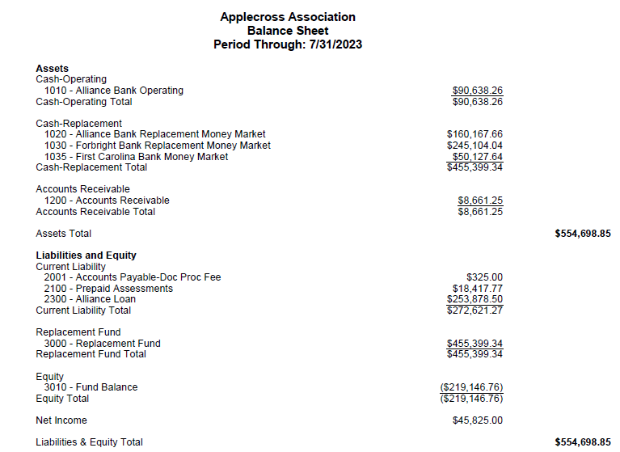
Applecross Financial Report:

Slide 10
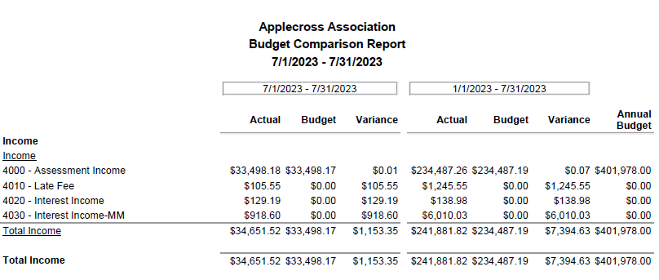
Applecross Financial Report:

Slide 11
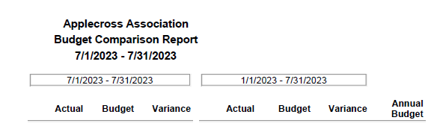
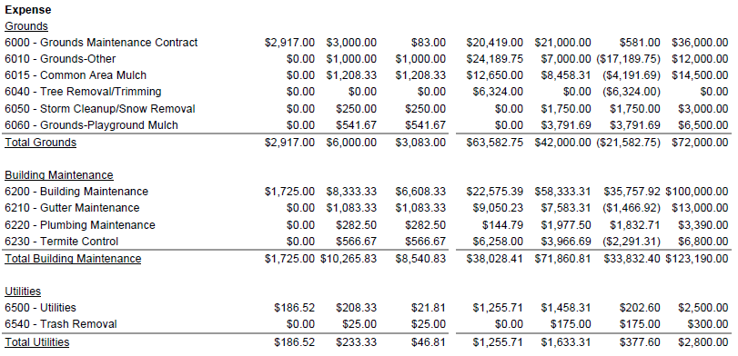
Applecross Financial Report:

Slide 12
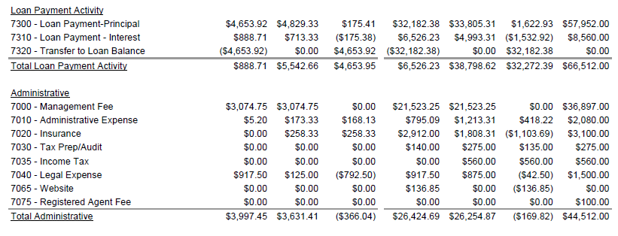
Applecross Financial Report:

Slide 13
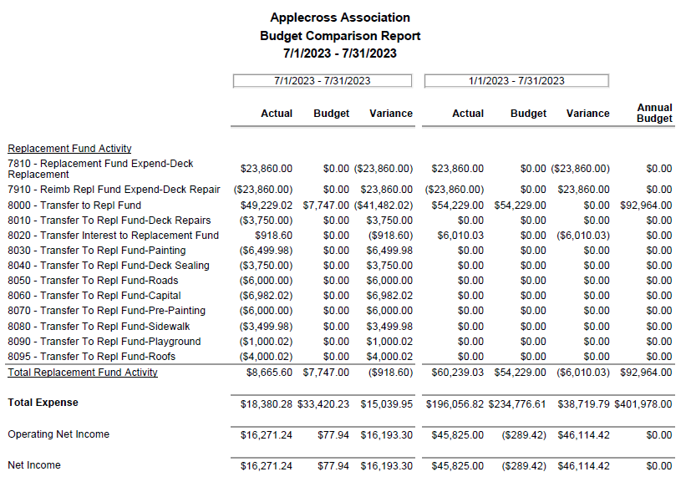
Applecross Financial Report:

Slide 14
Applecross 2024 Budget:

Slide 15
Applecross 2024 Budget:

Slide 16
Board Nominations
Nominations for the Board of Directors and Elections requires 10% of community to establish Quorum.
Joanna Willard
Floor nominations?

Slide 17
Questions?
17
Applecross Annual Meeting
October 12, 2023

Slide 18
Thank you
CAS HOA Management
Applecross HOA Board of Directors

